Slide 1
ACFR and
Single Audit Closing Process
June 6, 2023

Slide 2
Financial Accounting & Reporting Section
Staff
Stephanie Bailes, CPA
Betsy Chapman, CGFM
Renee King
Luke Murray
Matthew Reynolds
Timothy Scites
Robert Tanner
Vinutha Vishnu, CPA
Kay Walden, CGFM
Cindy Williams
Maria Yoakum

Slide 3
UNAUDITED AGENCY’S RESPONSIBILITY
Fixed Assets June 30, 2023
Leave Information July 7, 2023
SEFA Software July 31, 2023
Transmittal/Forms July 31, 2023

Slide 4
AUDITED AGENCY’S RESPONSIBILITY
Leave Warehouse July 7, 2023
SEFA Software July 31, 2023
Draft Financials Sept. 15, 2023
Final Financials Oct. 15, 2023

Slide 5
Required GASBs - 2023
Statement 91 – Conduit Debt Obligations
Statement 94 – Public-Private and Public-Public Partnerships and Availability Payment Arrangements
Statement 96 – Subscription-Based Information Technology Arrangements (SBITAs)
Statement 99 – Omnibus 2022 – Requirements for Leases, SBITAs and PPPs

Slide 6
Future GASBs – 2024
Statement 99 – Omnibus 2022 – Requirements for Financial Guarantees and Derivatives
Statement 100 – Accounting Changes and Error Corrections
Future GASBs – 2025
Statement 101 – Compensated Absences

Slide 7
Fixed Assets/Depreciation
Fixed Asset documents (FA, FM, FC, FD) cannot be pending on June 30, 2023. The wvOASIS mass depreciation is executed during the first week of July. Any pending documents will cause the depreciation to be incorrect for that asset.

Slide 8
OASIS SEFA App
Beginning Fiscal Year 2023

Slide 9
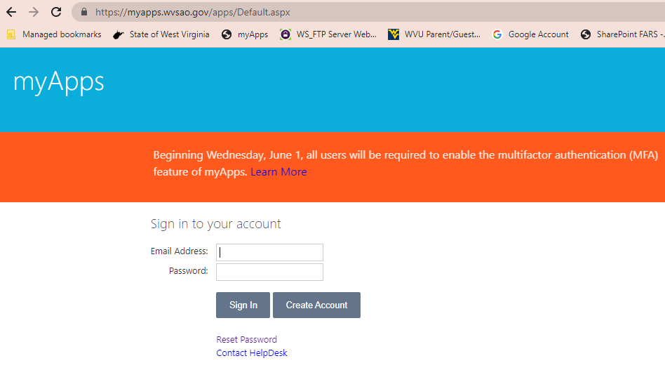
Go to OASIS myApps

Slide 10
Select the FARS option in myApps

Slide 11
Add a New Fund/Grant
Click the blue ‘New Grant’ button to enter data for a new fund and grants.

Slide 12
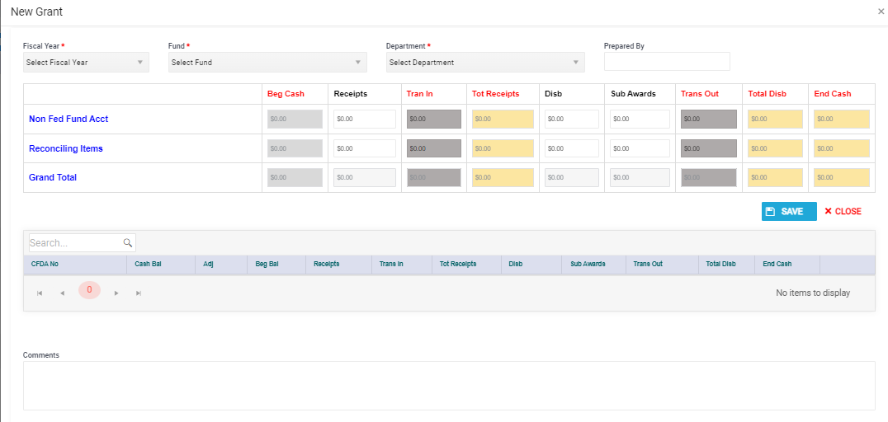
Required Fields indicated by *

Slide 13
The Edit Grant screen has two main sections, the Header and Detail.
The Header will summarize the Detail along with any activity entered in the Header such for reconciling items or nonfederal funds lines.
The Header must be saved before adding the Detail CFDA information.
There will be no buttons in the Detail until the Header is saved.

Slide 14
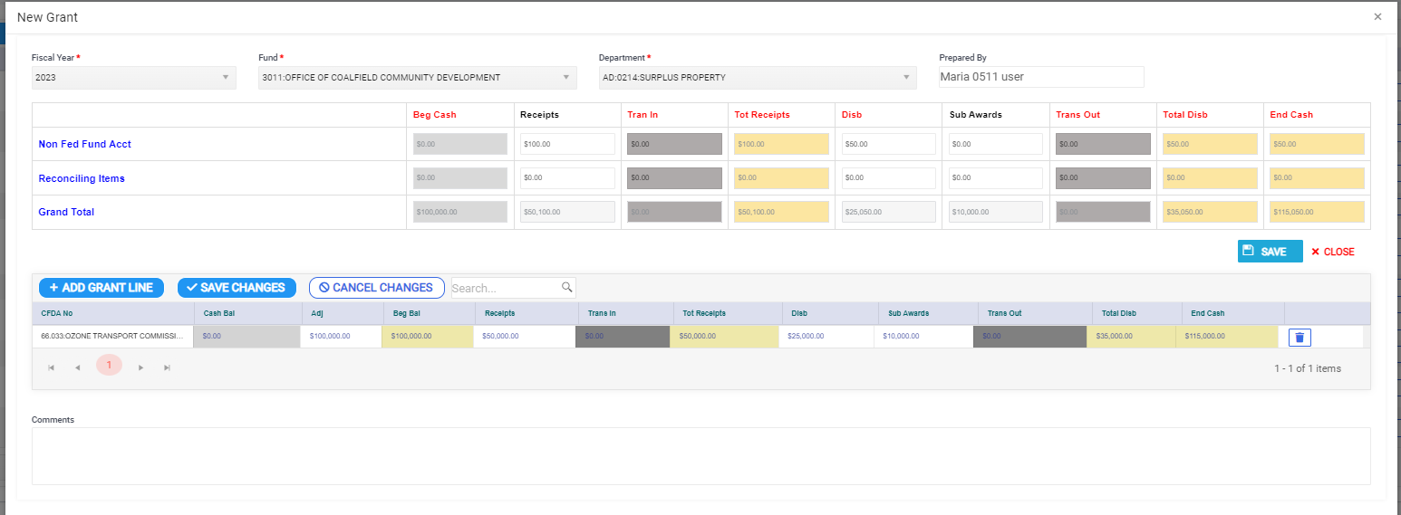
Header contains Nonfederal Fund and Reconciling Lines along with the Total for the Fund
The beginning balance cannot be adjusted for these two lines, changes will be run through receipts or disbursements.
Detail contains the Grant Information where beginning balances can be adjusted.

Slide 15
Edit Grant Screen
Light Grey = No entry allowed; pre-populated
White = Agency User Entry
Dark Grey = FARS entry
Yellow = Calculated Field

Slide 16
Always SAVE changes after grant
information is added to the app.
If the app is closed before it is saved, all information will be LOST!

Slide 17
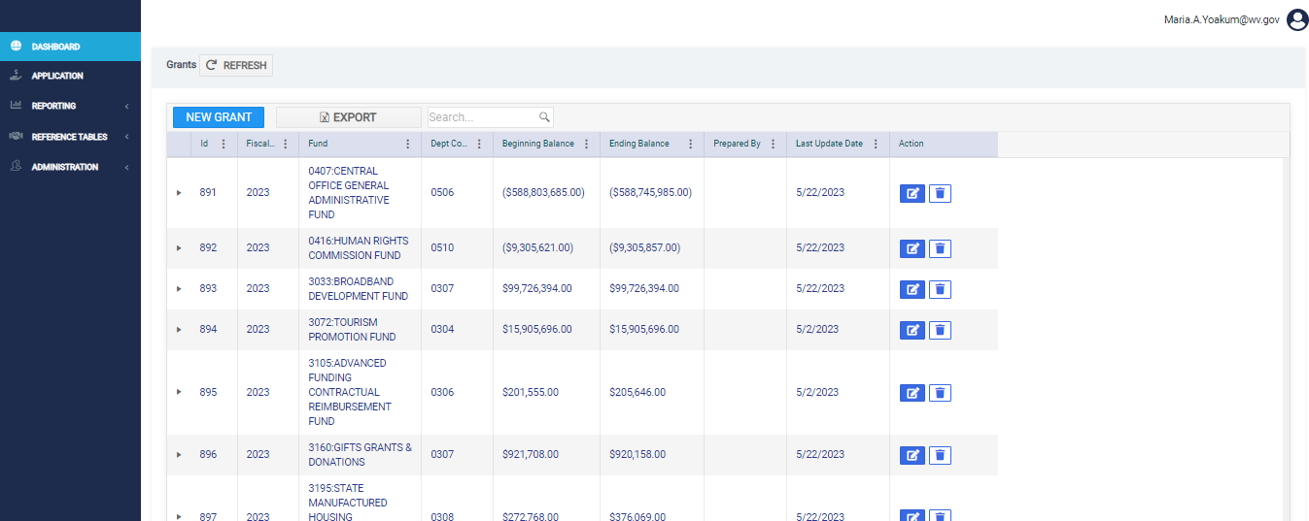
Search by FUND or Department Code

Slide 18
Edit Fund and Grants
Click on the ‘edit’ icon to make changes to an existing fund and the grants associated with the fund.

Slide 19
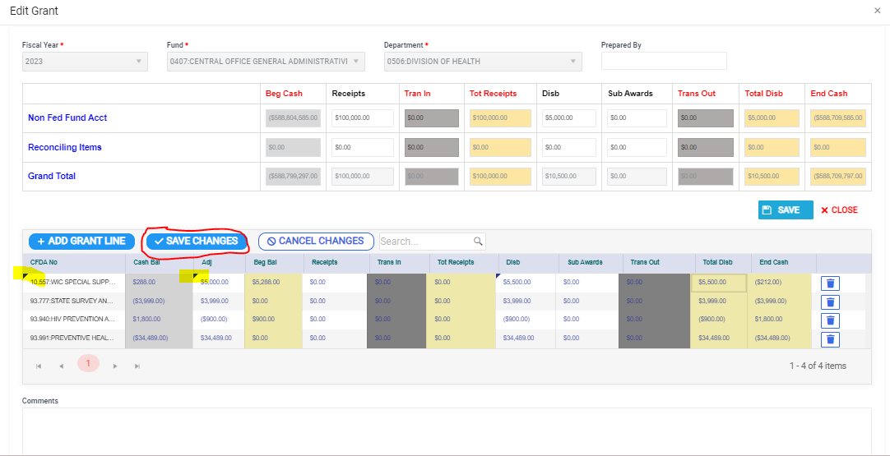

Slide 20
As changes are made to the Detail CFDA information, a black triangle will appear in the top-left corner of the cell. Once the ‘SAVE CHANGES’ button is clicked the black triangle will disappear indicating the data is saved. Please remember, you must click SAVE CHANGES in the DETAIL section before clicking the red CLOSE button or the CFDA information will not be saved.

Slide 21
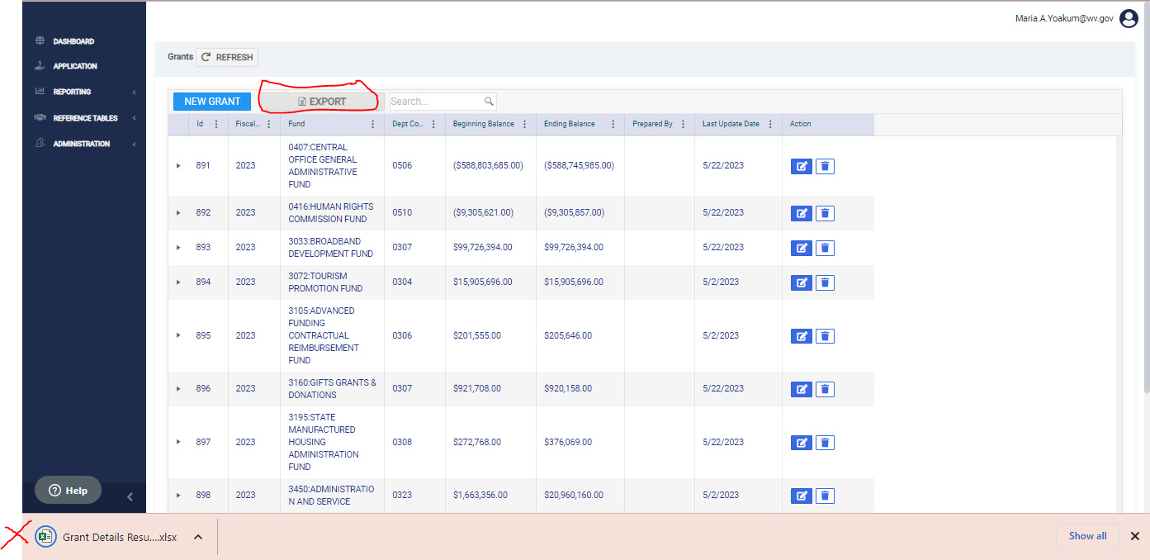

Slide 22
After being returned to the main screen click the REFRESH button at the top of the grid to see the updated information.

Slide 23
Reports
The reports are being worked on so there is currently no screen print or demonstration. Once the reports are available documentation will be uploaded to the FARS website and users will be notified.

Slide 24
Questions? Call/email: Betsy Chapman, Single Audit Coordinator Betsy.Chapman@wv.gov 304-414-9072 (office) 304-553-3692 (cell)

Slide 25
UNAUDITED AGENCY’S RESPONSIBILITY
Fixed Assets June 30, 2023
Leave Information July 7, 2023
SEFA Software July 31, 2023
Transmittal/Forms July 31, 2023

Slide 26
AUDITED AGENCY’S RESPONSIBILITY
Leave Warehouse July 7, 2023
SEFA Software July 31, 2023
Draft Financials Sept. 15, 2023
Final Financials Oct. 15, 2023

Slide 27
Contact Information
FARS: (304) 558-4083
Stephanie Bailes Stephanie.R.Bailes@wv.gov (304.414.9060)
Betsy Chapman Betsy.Chapman@wv.gov (304.414.9072)
Ernst & Young
Susan Wheeler, Partner Susan.Wheeler@ey.com (304.357.5974)

