Slide 1
ACFR and
Single Audit Closing Process
June 4, 2024

Slide 2
CPE
There will be three CPE codes throughout the presentation.
When the presentation is over, please email these codes to Maria.A.Yoakum@wv.gov to receive your CPE.
Your CPE certificates will be emailed to you within the next two weeks.

Slide 3
Financial Accounting & Reporting Section
Staff
Stephanie Bailes, CPA
Betsy Chapman, CGFM
Karla Harris, CFE, CGFM
Renee King
Luke Murray
Matthew Reynolds
Timothy Scites
Robert Tanner
Kay Walden, CGFM
Cindy Williams
Maria Yoakum

Slide 4
UNAUDITED AGENCY’S RESPONSIBILITY
Fixed Assets June 30, 2024
SEFA Software July 31, 2024
Transmittal/Forms July 31, 2024

Slide 5
AUDITED AGENCY’S RESPONSIBILITY
SEFA Software July 31, 2024
Draft Financials Sept. 15, 2024
Final Financials Oct. 15, 2024

Slide 6
Required GASBs – FY 2024
Statement 99 – Omnibus 2022 – Requirements for Leases, SBITAs and PPPs

Slide 7
Future GASBs
2025
Statement 101 – Compensated Absences
Statement 102 – Certain Risk Disclosures
2026
Statement 103 – Financial Reporting Model
Improvements

Slide 8
Fixed Assets/Depreciation A731
All fixed asset documents cannot be pending at
June 30, 2024.
The depreciation report will be run the first week of July. Any pending documents can cause the depreciation report to run incorrectly.

Slide 9
Pension and OPEB Employer Allocation Schedules
Employer allocation schedules:
Pensions available now
OPEB available now

Slide 10
Procedures
Forms will be on the website by July 1, 2024
http://www.finance.wv.gov/fars/acfr/pages/default.aspx
Submit all forms to:
FARSclosingbook@wv.gov

Slide 11
Prior Year Findings
Update and provide to Betsy Chapman
with SEFA closing book form submission
Form 13 – Unaudited agencies
Form 16 – Audited agencies
Form 6

Slide 12
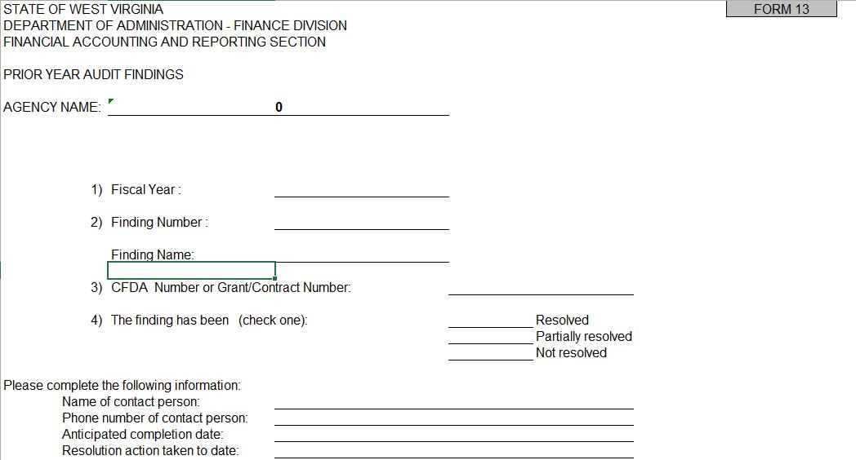
Form 6

Slide 13
OASIS SEFA App
Beginning Fiscal Year 2023

Slide 14
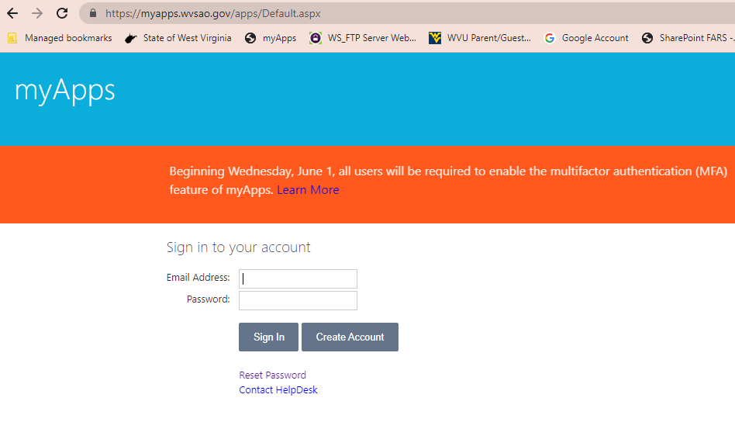
Go to OASIS myApps

Slide 15
Select the FARS option in myApps

Slide 16
Add a New Fund/Grant
Click the blue ‘New Grant’ button to enter data for a new fund and grants. FARS will have to enter these first and then they will be available to you.
Please contact Betsy Chapman if you have a Assistance Listing Number that needs added.

Slide 17
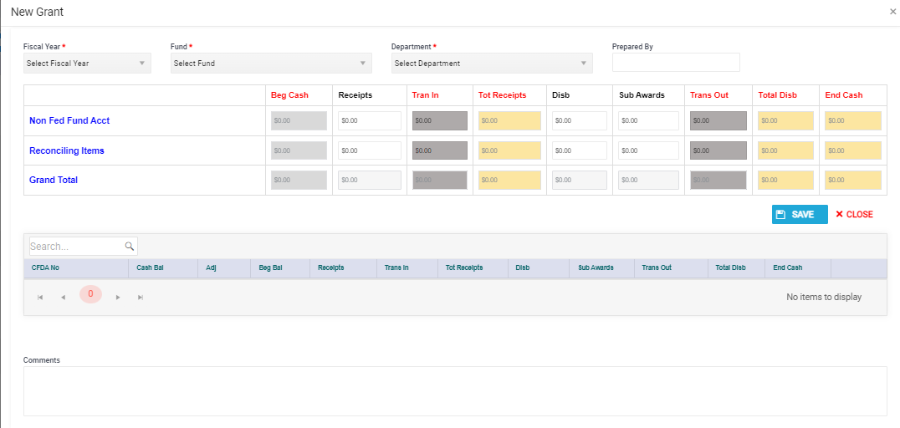
Required Fields indicated by *

Slide 18
B915
The Edit Grant screen has two main sections, the Header and Detail.
The Header will summarize the Detail along with any activity entered in the Header such for reconciling items or nonfederal funds lines.
The Header must be saved before adding the Detail CFDA information.
There will be no buttons in the Detail until the Header is saved.

Slide 19
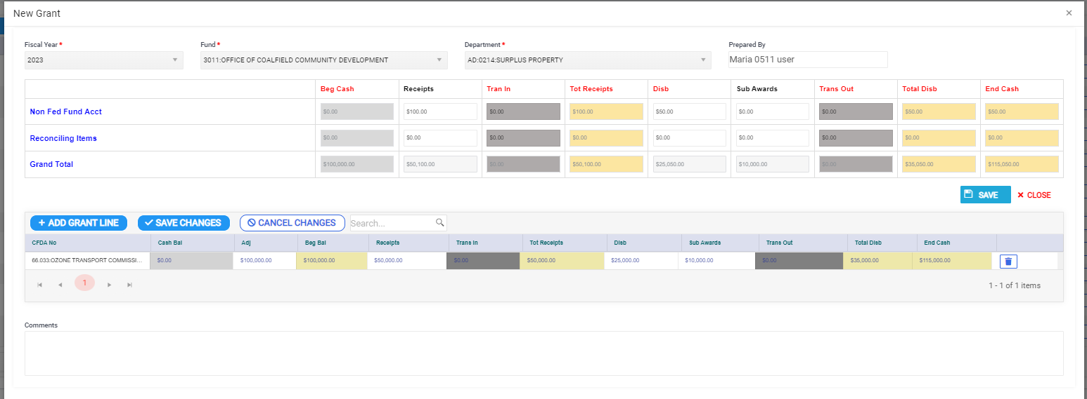
Header contains Nonfederal Fund and Reconciling Lines along with the Total for the Fund
The beginning balance cannot be adjusted for these two lines, changes will be run through receipts or disbursements.
Detail contains the Grant Information where beginning balances can be adjusted.

Slide 20
Edit Grant Screen
Light Grey = No entry allowed; pre-populated
White = Agency User Entry
Dark Grey = FARS entry
Yellow = Calculated Field

Slide 21
Always SAVE changes after grant
information is added to the app.
If the app is closed before it is saved, all information will be LOST!

Slide 22
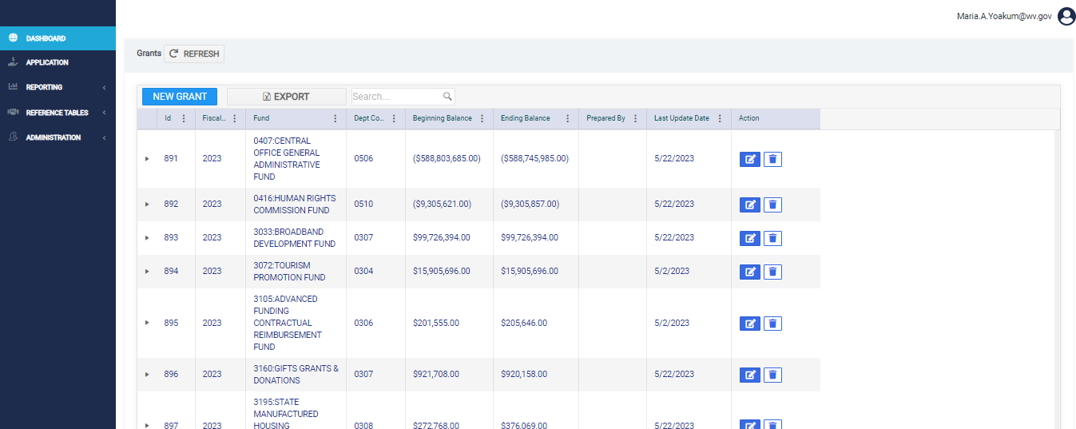
Search by FUND or Department Code

Slide 23
Edit Fund and Grants
Click on the ‘edit’ icon to make changes to an existing fund and the grants associated with the fund.

Slide 24
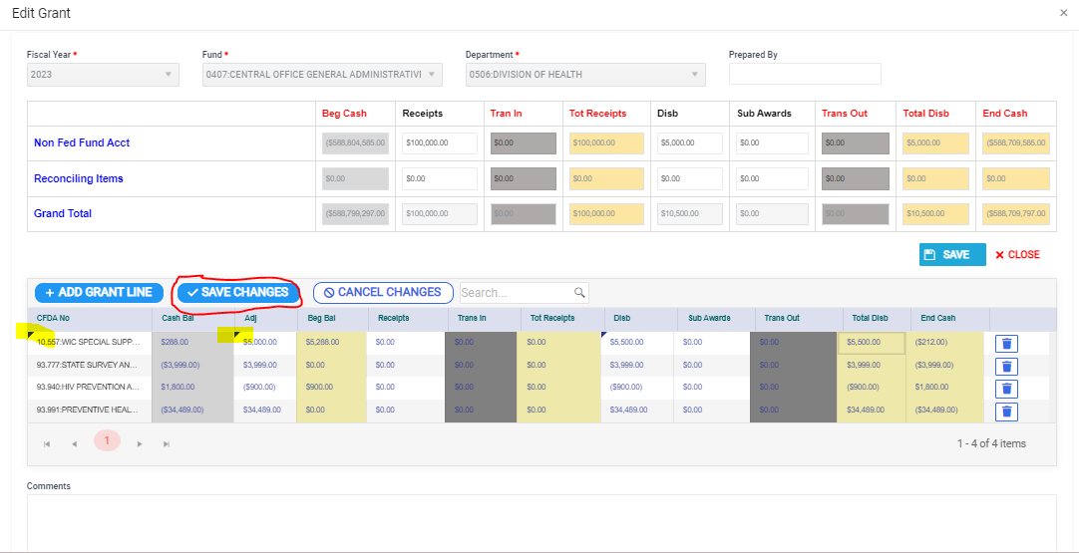

Slide 25
As changes are made to the Detail CFDA information, a black triangle will appear in the top-left corner of the cell. Once the ‘SAVE CHANGES’ button is clicked the black triangle will disappear indicating the data is saved. Please remember, you must click SAVE CHANGES in the DETAIL section before clicking the red CLOSE button or the CFDA information will not be saved.

Slide 26
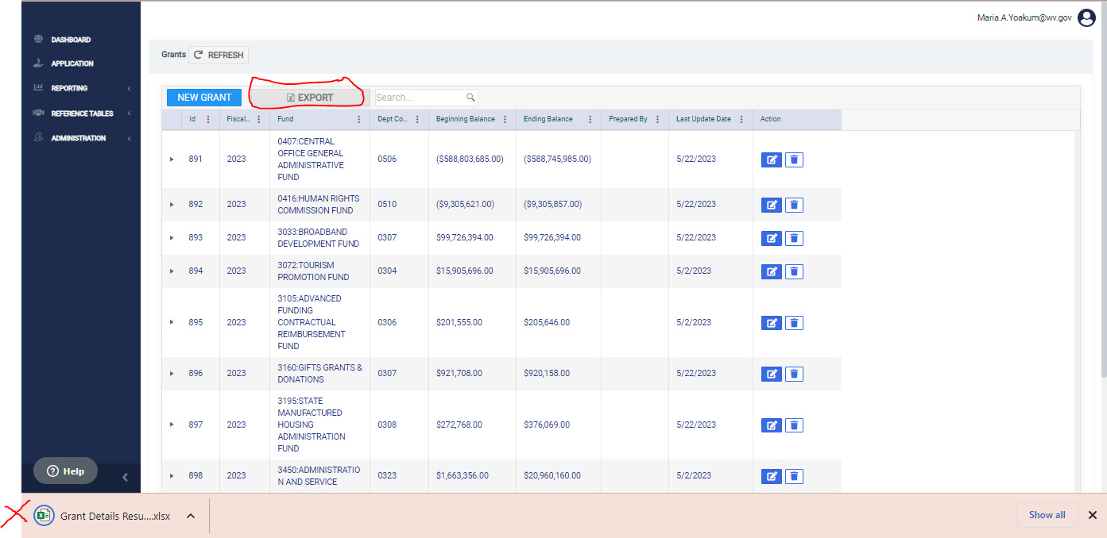

Slide 27
After being returned to the main screen click the REFRESH button at the top of the grid to see the updated information.

Slide 28
Reports C1015
Reports will be run in BI and submitted to FARS beginning in FY2024.
WV-SEFA-FARS-001 Federal Grant Report

Slide 29
Questions? Call/email: Betsy Chapman, Director of Single Audit Betsy.Chapman@wv.gov 304-414-9072

Slide 30
UNAUDITED AGENCY’S RESPONSIBILITY
Fixed Assets June 30, 2024
SEFA Software July 31, 2024
Transmittal/Forms July 31, 2024

Slide 31
AUDITED AGENCY’S RESPONSIBILITY
SEFA Software July 31, 2024
Draft Financials Sept. 15, 2024
Final Financials Oct. 15, 2024

Slide 32
Contact Information
FARS: (304) 558-4083
Stephanie Bailes Stephanie.R.Bailes@wv.gov (304.414.9060)
Betsy Chapman Betsy.Chapman@wv.gov (304.414.9072)
Ernst & Young
Lou Roberts, Partner Louis.Roberts@ey.com

