Slide 1
OASIS SEFA App
Beginning Fiscal Year 2023

Slide 2
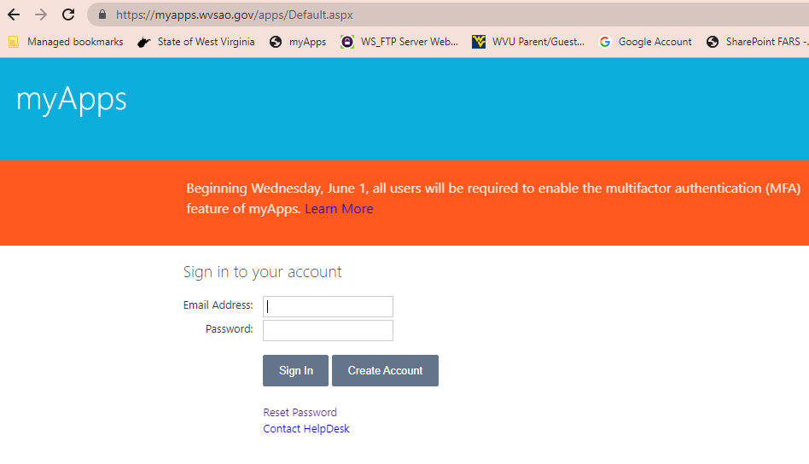
Go to OASIS myApps

Slide 3
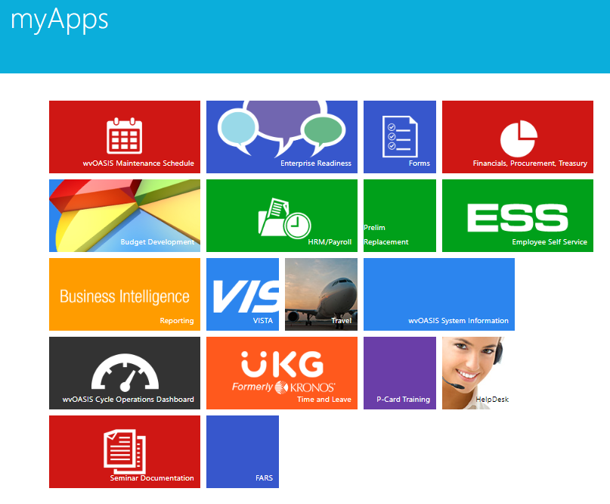
Select the FARS option in myApps

Slide 4
Add a New Fund/Grant
Click the blue ‘New Grant’ button to enter data for a new fund and grants.

Slide 5
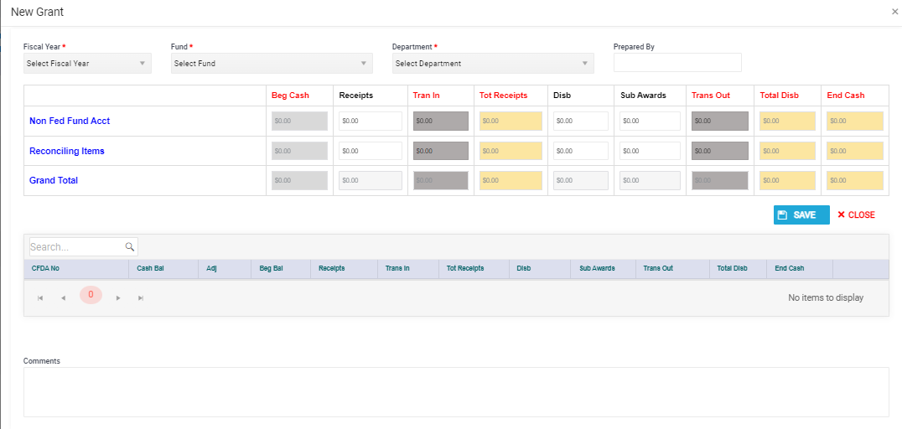
Required Fields indicated by *

Slide 6
The Edit Grant screen has two main sections, the Header and Detail.
The Header will summarize the Detail along with any activity entered in the Header such for reconciling items or nonfederal funds lines.
The Header must be saved before adding the Detail CFDA information.
There will be no buttons in the Detail until the Header is saved.

Slide 7
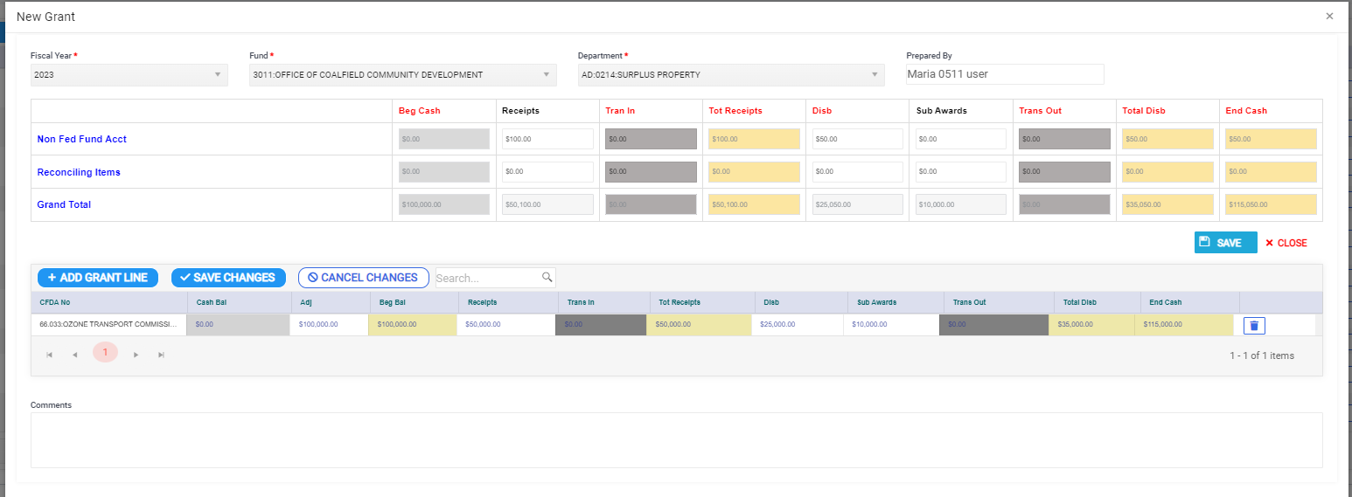
Header contains Nonfederal Fund and Reconciling Lines along with the Total for the Fund
The beginning balance cannot be adjusted for these two lines, changes will be run through receipts or disbursements.
Detail contains the Grant Information where beginning balances can be adjusted.

Slide 8
Edit Grant Screen
Light Grey = No entry allowed; pre-populated
White = Agency User Entry
Dark Grey = FARS entry
Yellow = Calculated Field

Slide 9
Always SAVE changes after grant
information is added to the app.
If the app is closed before it is saved, all information will be LOST!

Slide 10
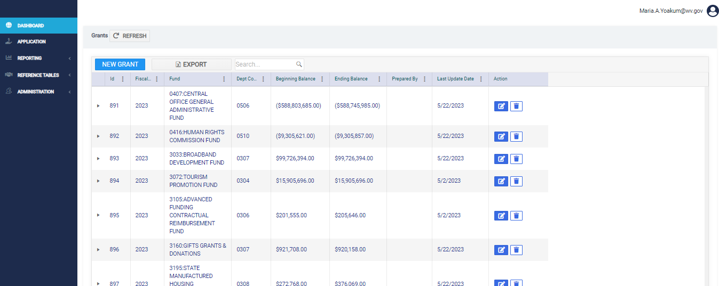
Search by FUND or Department Code

Slide 11
Edit Fund and Grants
Click on the ‘edit’ icon to make changes to an existing fund and the grants associated with the fund.

Slide 12
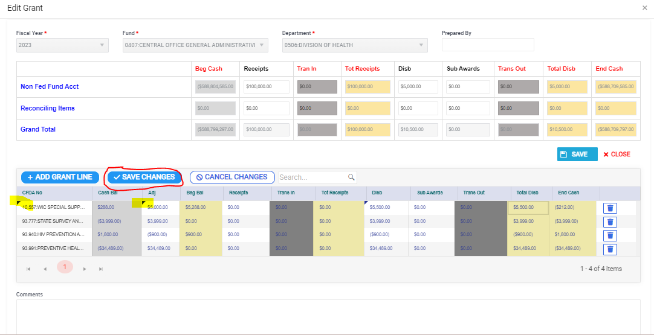

Slide 13
As changes are made to the Detail CFDA information, a black triangle will appear in the top-left corner of the cell. Once the ‘SAVE CHANGES’ button is clicked the black triangle will disappear indicating the data is saved. Please remember, you must click SAVE CHANGES in the DETAIL section before clicking the red CLOSE button or the CFDA information will not be saved.

Slide 14
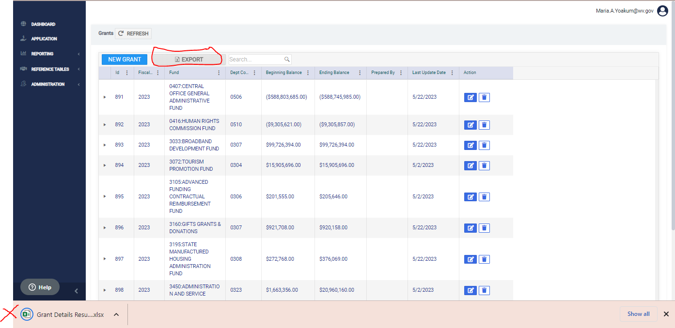

Slide 15
After being returned to the main screen click the REFRESH button at the top of the grid to see the updated information.

Slide 16
Reports
The reports are being worked on so there is currently no screen print or demonstration. Once the reports are available documentation will be uploaded to the FARS website and users will be notified.

Slide 17
Questions? Call/email: Betsy Chapman, Single Audit Coordinator Betsy.Chapman@wv.gov 304-414-9072 (office) 304-553-3692 (cell)

