Slide 1
ACFR and Single Audit Closing Process
Presented by: Alex McDonald, CPA
Deputy Director of Finance / Director of FARS
June 24, 2026

Slide 2
Agenda
  Background on the Financial Accounting and Reporting Section
  Deadlines
  FY 2026 GASBs
  Future GASBs
  Filling out the FARS Closing Book Forms
  Questions at the end
  Corey will go over Single Audit Prep in the next session

Slide 3
Financial Accounting & Reporting Section Staff (FARS)
Melody Duke
Alex McDonald, CPA
Kari Davis
Bryan Day
Karla Harris, CGFM, CFE
John Jones, CPA
John Newman
Timothy Scites
Corey Wade, CGFM
Kay Walden, CGFM
Maria Yoakum

Slide 4
Who We Are
WV Code §5A-2-33 Mandate:
Issue an annual comprehensive financial report (ACFR)
“Have the general purpose financial statements of the state audited annually by independent certified public accountants.”
Source: (Financial accounting and reporting section; comptroller; powers and responsibilities, 1991)

Slide 5
What We Do
Annual Comprehensive Financial Report (ACFR)
Statewide Cost Allocation Plan (SWCAP)
Single Audit

Slide 6
Important Deadlines – Unaudited Agencies
July 31st ALL closing books

Slide 7
Important Deadlines – Audited Agencies
July 31st SEFA closing books
September 15th draft financials
September 15th ALL other closing book forms
October 15th final financials

Slide 8
New GASBs for FY26
GASB 103
  It will “improve key components of the financial reporting model to make it more effective for decision making and assessing a government’s accountability.”
GASB 104
  It will provide users “with essential information about certain types of capital assets”
  Capital assets held for sale
Sources: (GASB Statement No. 103, 2024, summary para. 1)
(GASB Statement No. 104, 2024, summary para. 1)

Slide 9
Future GASB
GASB 105 - Subsequent Events
  Will clarify subsequent event timing and how it will constitute recognized and non- recognized events.
  Specify informative items required to be disclosed about subsequent events.
  Effective date will be for fiscal years beginning after June 15, 2026.
Sources: (GASB Statement No. 105, 2025, summary para. 3)

Slide 10
Information
Can be found on our website:
https://finance.wv.gov/closing-book-process-0
There will be an email with a separate link sent to each department to access closing book forms.

Slide 11
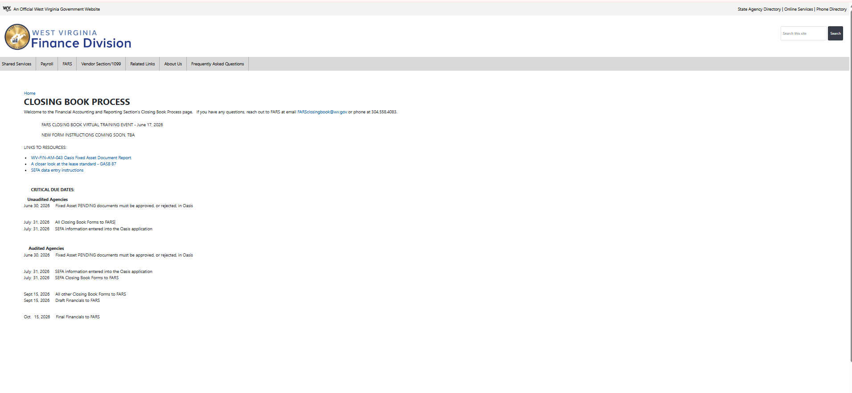

Slide 12
Workiva
Structural Reorganization
Restructuring
Unified Framework
Process Modernization
Digitizing
Simplifying

Slide 13
Closing Book Forms
Outside Cash
Due To/ Due From
https://app.wdesk.com/a/w_f268d023f9044a12a27dc92aee1b7971/spreadsheet/c904dffc037f45d38bd201030058adba/-1/sheet/1102aba7b67a4053b47f0889eb9eda0b

Slide 14
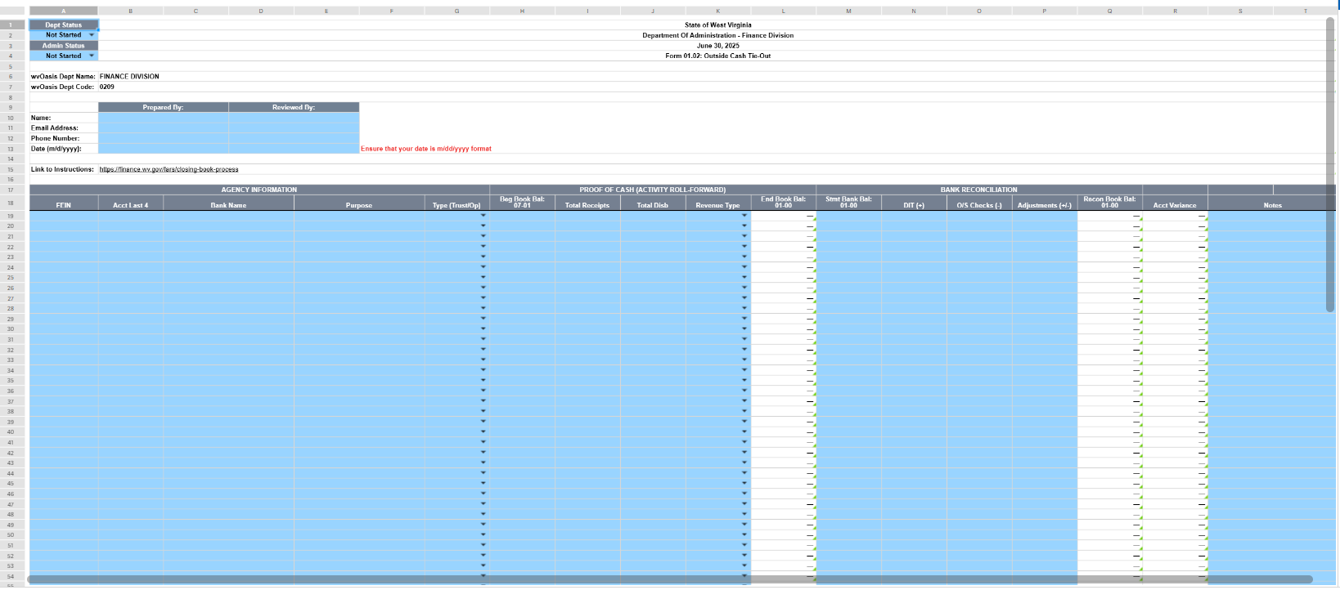

Slide 15
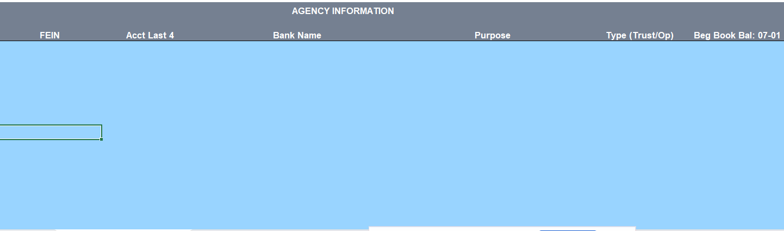

Slide 16
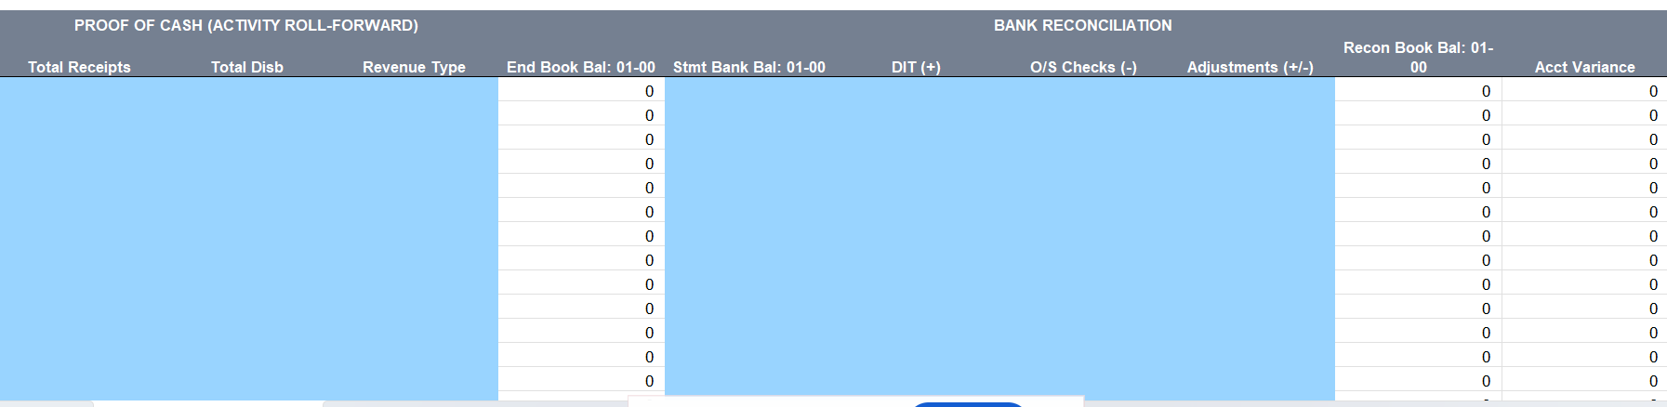

Slide 17
Due From/Due To Form
Due From Other Agencies
  Combining Two Previous Forms
    Due From Other State Agencies
    Due From Component Units
Due To Other Agencies
  Combining Two Previous Forms
    Due To Other State Agencies
    Due To Component Units

Slide 18
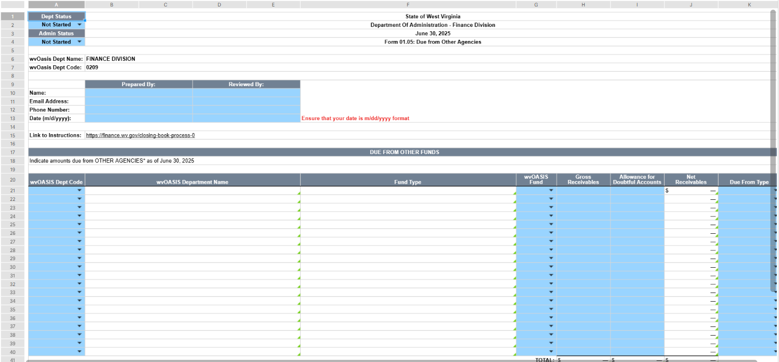

Slide 19
Fixed Assets
Finalize outstanding documents
Held for sale fixed assets
Forms
  Capital Assets
  Construction in Progress
  Completed Construction in Progress
  Other Assets
  Asset Impairment
  Certain Asset Retirement

Slide 20
Workiva FAQ
Can multiple individuals be in the forms at the same time? Yes
Can a login be shared? No
Does marking one form as “complete” affect other forms in the packet? No
When can we expect the forms to be available? Aiming for late June early July

Slide 21

Q&A
Contact us by email: FARSclosingbook@wv.gov or phone (304) 558-4083.

Slide 22
References
Governmental Accounting Standards Board. (2024). Financial reporting model improvements. (GASB Statement No. 103). GASB.
Governmental Accounting Standards Board. (2024). Disclosure of certain capital assets. (GASB Statement No. 104). GASB.
Governmental Accounting Standards Board. (2025). Subsequent Events. (GASB Statement No. 105). GASB.
Financial accounting and reporting section; comptroller; powers and responsibilities, WVa. Stat. § 5A-2-33 (1991).

