Slide 1
Single Audit / SEFA Preparation Process
Presented by: Corey Wade, CGFM
Single Audit Coordinator
June 24, 2026

Slide 2
Agenda
What is a Single Audit?
  Single Audit Act
  Uniform Guidance
    Compliance Supplement
Single Audit Key Terms
Determining Major Programs
  Preliminary Major Programs for FY 26
SEFA Preparation / Deadlines
  Closing Book Forms (Workiva)
  SEFA App Data Entry
Single Audit Findings
  Corrective Action Plan

Slide 3
What is a Single Audit?
Single Audit
Mandated by the Single Audit Act of 1984
An organization-wide financial and compliance audit of non-federal entities exceeding $1 million dollars in federal awards.
Uniform Guidance
Comprehensive framework for managing federal awards.
Organized into six subparts, covering distinct aspects of federal award management.
Acronyms and definitions
General provisions
Pre-award requirements
Post-award requirements
Cost principles
Audit requirements

Slide 4
Code #4
H693
Notes:
Here is the first code. Please take a minute to write it down. I will wait approximately 30 seconds to a minute before proceeding.

Slide 5
Key Terms for Single Audit
SEFA (Schedule of Expenditures of Federal Awards): Schedule that includes the total federal expenditures (WV expenditures + subrecipient awards) per program/ALN and federal grantor.
ALN (Assistant Listing Number): Unique number assigned to a federal program. (CFDA previously)
Cluster of programs: A grouping of programs considered one program for audit testing purposes.
Compliance Supplement: Authoritative source of information used to understand the programs objectives , procedures, compliance requirements, and suggested audit procedures. (Updated annually)

Slide 6
Key Terms for Single Audit (cont.)
Disbursements: The movement of funds from one location to another. Includes expenditures and transfers.
Expenditures: Charges made by recipient or subrecipient to a federal program.
Cash disbursements for direct charges for properties and services.
Amount of indirect expense charge
Amount of cash advance payments
Payments made to subrecipients
Non-cash contributions
Subaward: An award provided by a pass-through entity to a subrecipient to carry out part of a federal program.

Slide 7
Key Terms for Single Audit (cont.)
Recipient: An entity that receives a federal award directly from a federal agency.
Subrecipient: An entity that receives an award from a pass-through entity to carry-out part of a federal award.
Pass-through entity: Recipient that provides an award to a subrecipient.
Major program: Federal program that is determined by the auditor to be major in accordance with to 2 CFR Part 200.

Slide 8
Determining Major Programs
Auditor determines major programs based on a risk approach
  Identifies programs as Type A or Type B
  WV Type A threshold = Programs with expenditures over .3% of the total federal awards expended
  Type A programs are around at least $25M in expenditures
  All other programs are Type B
Identify high risk Type A and Type B programs
All high-risk Type A and Type B programs are major
A risk assessment is performed on all type A programs to determine low or high risk
A risk assessment is only performed on Type B programs with expenditures that are over 25% of the Type A threshold or around $6M in expenditures in our case.
A lot of our high-risk programs are dropping to low risk due to them being selected as major in the last two years and less findings – mention R&D possibly not being major this year but will still have to be presented correctly on the SEFA.
Other programs identified as major to meet the percentage of coverage rule
Total major programs must be at least 40% of total federal award expenditures.

Slide 9
Determining Major Programs (cont.)
Identify high risk Type A and Type B programs
A risk assessment is performed on all Type A programs to determine low or high risk
A risk assessment is only performed on Type B programs with expenditures that are over 25% of the Type A threshold or around $6M in expenditures in our case.
All high-risk Type A and Type B programs are considered major.
Other programs identified as major to meet the percentage of coverage rule
Total major programs must be at least 40% of total federal award expenditures for non-low-risk clients.

Slide 10
Potential Major Programs FY 2026
1. Child Nutrition Cluster – PY Material Weakness Finding.
2. Abandoned Mine Land Reclamation – Potential high-risk program (Waiting on final compliance supplement) PY Significant Deficiency Finding
3. Unemployment Insurance – PY Material Weakness Finding
4. Temporary Assistance for Needy Families – PY Material Weakness Finding
5. Child Care Development Fund – PY Material Weakness Finding
6. Medicaid Cluster – High risk program
7. Child and Adult Care Food Program – Large Type B to replace low risk As/gain adequate audit coverage
8. Summer EBT Program – Large Type B to replace low risk As/gain adequate audit coverage
9. Food Distribution Cluster – Large Type B to replace low risk As/gain adequate audit coverage
10. Workforce Innovation and Opportunity Act Cluster – Large Type B to replace low risk As/gain adequate audit coverage
11. Social Security Disability Insurance – Large Type B to replace low risk As/gain adequate audit coverage

Slide 11
Potential Major Programs FY 2026
Qualified Opinion in FY 25 w/ Material Weaknesses
Child Nutrition Cluster
Unemployment Insurance
Temporary Assistance for Needy Families
Child Care Development Fund Cluster
Unmodified Opinion in FY 25 w/Significant Deficiency
Abandoned Mine Land Reclamation
Medicaid Cluster
Potentially Major in FY 26 but Not Major in FY 25
Child and Adult Care Food Program
Summer EBT Program
Food Distribution Cluster
Workforce Innovation and Opportunity Act Cluster
Social Security Disability Insurance Cluster

Slide 12
SEFA Preparation
SEFA Closing Book Forms
Due date: July 31st
SEFA Application Data Entry
Due date: July 31st
Provide a SEFA Reconciliation and Documentation
Transaction detail for expenditures

Slide 13
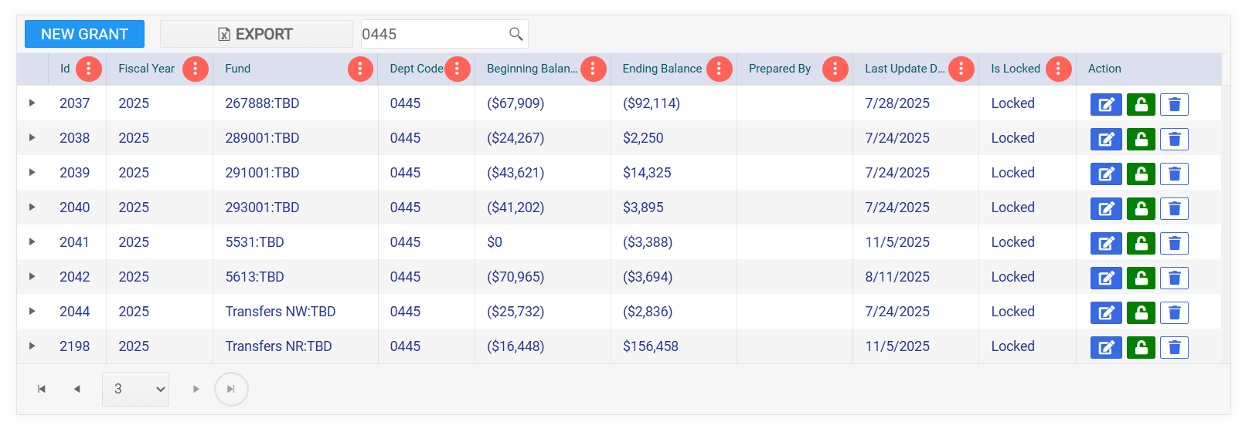

Slide 14
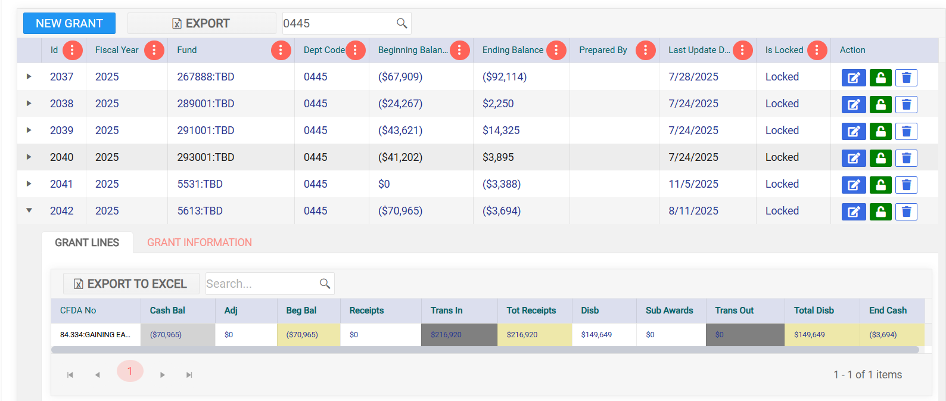

Slide 15
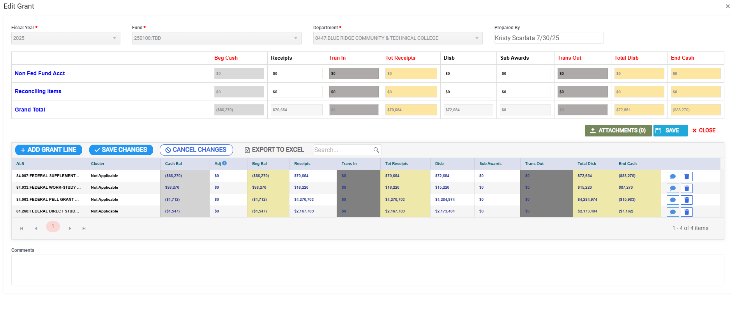











NEW LOOK FY 26

Slide 16
Code #5
M720
Notes:
Here is the first code. Please take a minute to write it down. I will wait approximately 30 seconds to a minute before proceeding.

Slide 17
Program Clusters
Compliance supplement identifies most Program Clusters
  Program clusters are to be considered on program for audit testing. An example is the child Nutrition Cluster.
  Child Nutrition Cluster
    School Breakfast Program
    National School Lunch Program
    Special Milk Program for Children
    Summer Food Service Program for Children
    Fresh Fruit and Vegetable Program
  Programs that are a part of the Research & Development Cluster are NOT identified in the compliance supplement.

Slide 18
Findings/Corrective Action Plans
Single Audit Finding: A deficiency or non-compliance regarding adherence to a federal program’s requirements. The auditor is required to report all findings in the schedule of findings and questioned costs.
  Significant Deficiency: Less severe. More of a warning sign.
  Material Weakness: Serious deficiency. Reasonable possibility that a non-compliance is or will occur and will not be prevented, detected, or corrected in a timely manner.
IMPORTANT: Be sure you agree with the finding content and verbiage prior to writing your corrective action plan.

Slide 19
Findings/Corrective Action Plans
Corrective Action Plan (CAP): A plan written by the audited agency that details the steps that will be taken to correct identified deficiencies and produce recommended improvements.
Key Elements of CAP:
•Summarize the nature of the finding and its impact
•Specify the actions that will be implemented to correct the finding
•Identify the individual(s) or department(s) accountable for implementing the corrective action. No pronouns (we, he, she). BE SPECIFIC on who exactly will be performing the actions. (Director of Finance, Accounting Section)
•Provide a realistic timeframe for completing each step, including milestones if necessary.
•Describe how your entity will monitor the implementation and effectiveness of the CAP.

Slide 20
Code #6
Y216
Notes:
Here is the first code. Please take a minute to write it down. I will wait approximately 30 seconds to a minute before proceeding.

Slide 21
FY 2025 Findings Summary
Total Findings: 22 (FY 24: 58)
Significant Deficiency: 17
Material Weakness: 5

Slide 22
SEFA CLOSING BOOK FORMS
FY 2026

Slide 23

Q&A
Contact us by email: FARSclosingbook@wv.gov or phone (304) 558-4083.

